Slide 1
Examine your self in
Paed ECG

Slide 2
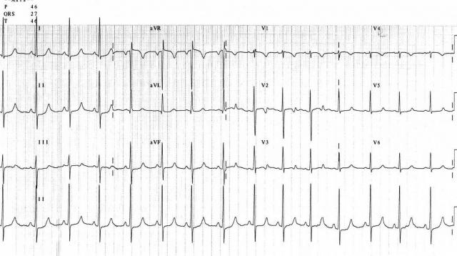

Slide 3
ECG 1 is a normal ECG of an 8-year-old child, showing sinus rhythm, a heart rate of 90 beats/min, with a normal QRS axis of 30 degrees.

Slide 5
rhythm strip shows a sinus arrhythmia.
varies with respiration and is entirely normal.

Slide 6
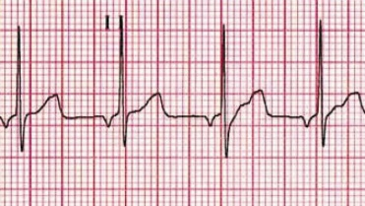

Slide 7
patient with a low atrial rhythm

Slide 8
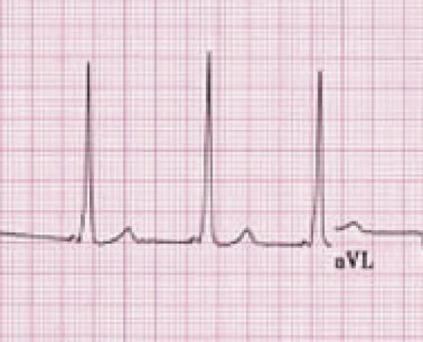

Slide 9
WPW syndrome.

Slide 11
asymptomatic 8-year-old girl with congenital complete heart block.

Slide 12
If encountered in an infant, the child’s mother should be investigated for systemic lupus erythematosus by doing Ro and La antibodies. Heart block may also be seen after corrective surgery for congenital heart disease.

Slide 14
A 9-year-old girl with a history of sudden collapse, showing a prolonged QT interval.

Slide 15
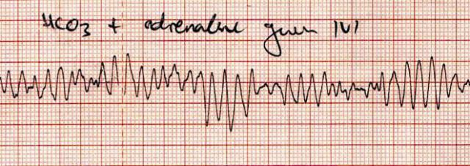
A child who presented to the emergency department in severe shock

Slide 16
He was found to be pulseless and during chest compressions received adrenaline boluses and bicarbonate. When the ECG tracing revealed intermittent torsades de pointes

Slide 17
Patient defibrillated and successfully returned to sinus rhythm.
He was subsequently diagnosed with a
dilated cardiomyopathy, without long QT.

Slide 18
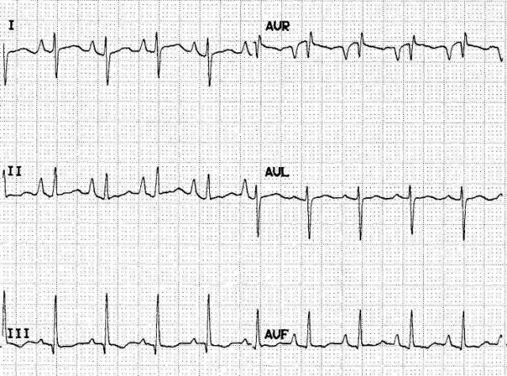

Slide 19
4-year-old child with pulmonary hypertension. ECG 11 is of a 4-year-old child with severe kyphoscoliosis and pulmonary hypertension. His ECG has as rightward mean frontal QRS axis and shows right atrial hypertrophy.

Slide 20
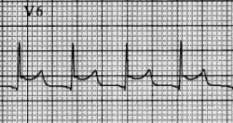

Slide 21
. ST-segment elevation in a child who developed a pericardial effusion after VSD repair.

Slide 23
a neonate who presented to the day hospital with poor feeding; the nursing staff noted a tachycardia. He had a SVT which was terminated with adenosine, diagnosed with atrial flutter and needed cardioversion . Once cardioverted, atrial flutter hardly ever recurs.

Slide 24
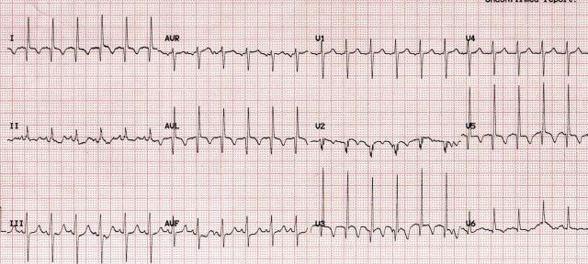
4-month-old child who presented in congestive cardiac failure.

Slide 25
deep Q waves in leads I, aVL, V2 and V3, indicating an anterolateral myocardial infarct pattern. Deep Q waves are also seen in V5. This patient, who had cardiogenic shock secondary to cardiomyopathy, had an anomalous left coronary artery from the pulmonary artery (ALCAPA). The condition, diagnosable by ECG, is surgically correctable. It is therefore imperative that all children presenting with dilated cardiomyopathy have an ECG as part of their routine initial investigation.

Slide 26
Q waves represent the depolarisation of the interventricular septum. They are normally visible in lead I, II, III, aVF, V5, V6, but their duration should be less than 0.03 s, and they should be less than 5 mm deep.

